Slide 1
Features Most Important to Predict Life Expectancy
Machine Learning Final Project
https://drive.google.com/file/d/1_Pdf1B3lcZn5U4HB9aAEBygmOYeDbr25/view?usp=sharing

Slide 2
Feature name | Definition
Adult Mortality Rates | Probability of dying between 15 and 60 years per 1000 population
Infant deaths | Number of Infant Deaths per 1000 population
Alcohol | Recorded per capita (15+) consumption (in litres of pure alcohol)
Expenditure on health | Expenditure on health as a percentage of Gross Domestic Product per capita(%)
Hepatitis B (HepB) | Immunization coverage among 1-year-olds (%)
Measles | Number of reported cases per 1000 population
BMI | Average Body Mass Index of entire population
Under-five deaths | Number of under-five deaths per 1000 population
Polio | Immunization coverage among 1-year-olds (%)
Dataset from Kaggle

Slide 3
Feature name | Definition
Government expenditure | General government expenditure on health as a percentage of total government expenditure (%)
Diphtheria | Diphtheria tetanus toxoid and pertussis (DTP3) immunization coverage among 1-year-olds (%)
HIV/AIDS | Deaths per 1 000 live births HIV/AIDS (0-4 years)
GDP | Gross Domestic Product per capita (in USD)
Population | Population of the country
Thinness (10-19) | Prevalence of thinness among children and adolescents for Age 10 to 19 (% )
Thinness (5-9) | Prevalence of thinness among children and adolescents for Age 5-9(% )
Human Development Index | How productively the population uses resources (0-1)
Schooling | Number of years of Schooling(years)
Dataset from Kaggle

Slide 4

Model 2: SVR (Support Vector Regression)
SVR will only consider distance of slack variables from the line, unlike linear regression which sums differences of every point from line and minimizes that

Slide 5
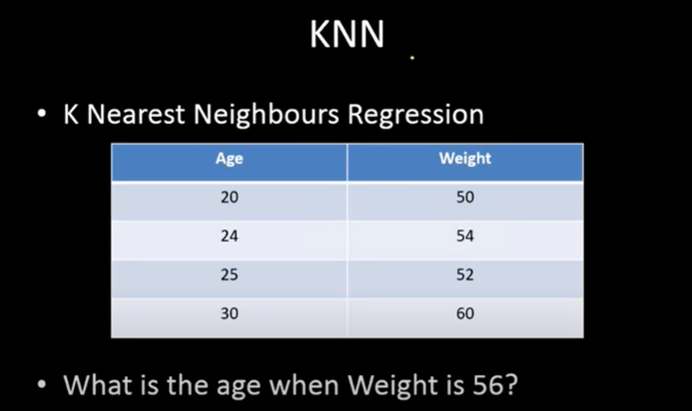
Model 3: K Neighbors Regressor
Credit: https://www.youtube.com/watch?v=1ETPnTG2mLg

Slide 6
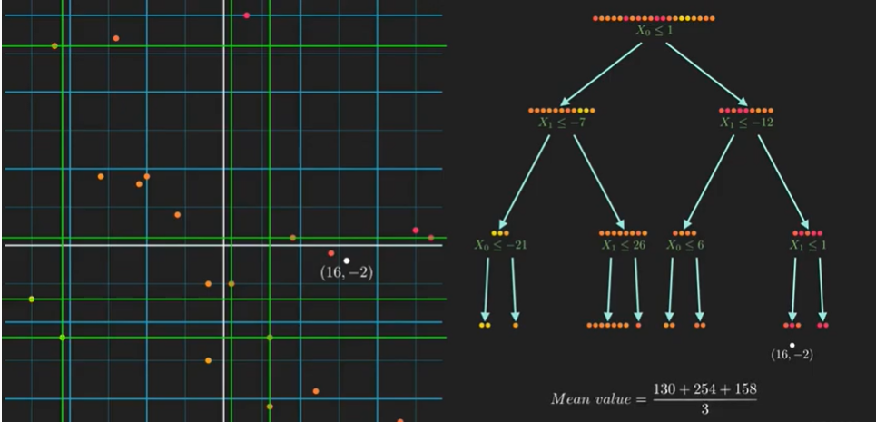
Model 4: Decision Tree Regressor
A decision tree is arriving at an estimate by asking a series of questions to the data, each question narrowing our possible value until the model get confident enough to make a single prediction
Credit: https://www.youtube.com/watch?v=UhY5vPfQIrA&t=66s

Slide 7
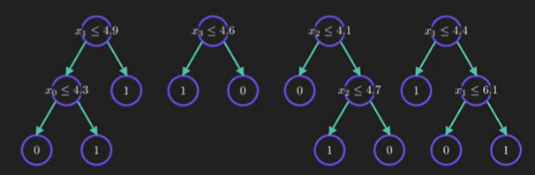
Model 5: Random Forest Regressor
Often, a single tree is not sufficient for producing effective results. Random-forest machine learning algorithm that leverages the power of multiple decision trees for making decisions. Each node in the decision tree works on a random subset of features to calculate the output. The random forest then combines the output of individual decision trees to generate the final output

Slide 8
Conclusion:
Random Forest Regressor proved to be the most accurate in predicting life expectancies
HIV/AIDS, Income composition of resources, Schooling proved to be three consistently important features used to predict life expectancy

